Slide 1
SMART DUSTBIN
ADITI KAUSHIK , ANUBHAV ANAND , NIYONIKA , RIYA MISHRA , SHUBHRO N. TYAGI,SUYASH A. TRIVEDI
Notes:
Be specific and direct in the title. Use the subtitle to give the specific context of the speech.
-The goal should be to capture the audience’s attention which can be done with a quote, a startling statistic, or fact. It is not necessary to include this attention getter on the slide.

Slide 2
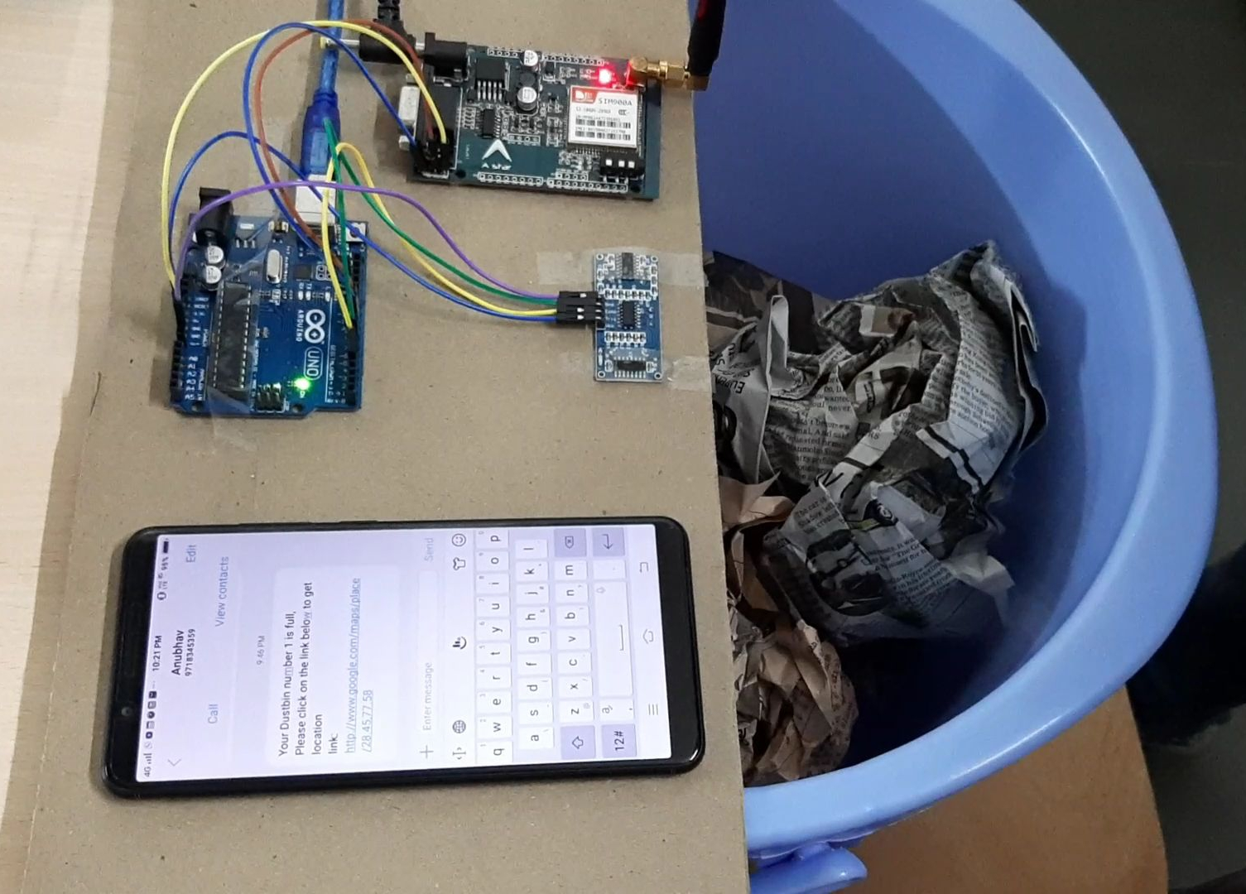
THE SMART DUSTBIN
Smart Trash Collector is a type of garbage bin which can ease the human effort in collecting trash.
This will notify which trash bin is full or empty. In other words it will tell you about the status of your bin.
If there are lots of trash across the city it will message the trash collector about the full trash and will mark the shortest direction on google maps towards that trash bin.
[Use this space to place an image that best captures the main idea of the speech]
Notes:
Use the background points to post details that are not common knowledge, or that the audience will need to understand the context of the speech.
-Do not read these main points from the PowerPoint, instead elaborate on these points during the speech.

Slide 3
CURRENT TECHNOLOGY V/S SMART DUSTBIN
CURRENT TECHNOLOGY | SMART DUSTBIN
Manually check all trash across the city. | Will get notification about the status of trash bin.
Consumes lots of fuel, time, money and labour. | Will save fuel, time, money & labour up to 80-90%.
Can lead to traffic jam on roads | Reduces traffic jam on roads.
Notes:
Dedicate this entire slide to the thesis statement. It is the reason the speech is being given. Use this time to reveal the three main points of the speech (slides 4,5,6) as an overview for the direction of the speech:
-[type main point #1 here]
-[type main point #2 here]
-[type main point #3 here]
Be sure to transition to the first main point and the next slide.

Slide 4
Who is the target?
Anyone who collects disposals, they can be some waste management agency, some department of government or maybe scrap dealer.
Notes:
The counterargument should be the most common argument against the topic. The goal for this slide is to address the counterargument in such a way as to actually strengthen the original topic. Be sure to address each piece of evidence against the topic. As you address each piece of evidence elaborate on the text found on the slide. Remember to transition to the final slide, the action step.

Slide 5
What do they need?
It wastes a lot of time to keep on wandering around in the city to check if the trash cans are full or not.
It is time consuming and take wastes a whole lot of fuel.
This is where the IOT device will help people, by telling them when the cans are full and showing them the easy route to the same.
Notes:
The counterargument should be the most common argument against the topic. The goal for this slide is to address the counterargument in such a way as to actually strengthen the original topic. Be sure to address each piece of evidence against the topic. As you address each piece of evidence elaborate on the text found on the slide. Remember to transition to the final slide, the action step.

Slide 6
Where does it apply?
This will help in keeping the waste disposal agencies informed about whether the trash cans are empty or not.
Notes:
The counterargument should be the most common argument against the topic. The goal for this slide is to address the counterargument in such a way as to actually strengthen the original topic. Be sure to address each piece of evidence against the topic. As you address each piece of evidence elaborate on the text found on the slide. Remember to transition to the final slide, the action step.

Slide 7
How does it work?
Our system gives a real time indicator of the garbage level in a trashcan at any given time. Using that data we can then optimize waste collection routes and ultimately reduce fuel consumption.
Notes:
The counterargument should be the most common argument against the topic. The goal for this slide is to address the counterargument in such a way as to actually strengthen the original topic. Be sure to address each piece of evidence against the topic. As you address each piece of evidence elaborate on the text found on the slide. Remember to transition to the final slide, the action step.

Slide 8
THE BASIC APPROACH
We can use a ultrasonic sensor and weight sensor to calculate the amount of waste and the level of waste inside the dustbins.
We can use a gsm module to notify the responsible person or organization of the status of dustbins through a simple message and if full send it’s location .
Notes:
The counterargument should be the most common argument against the topic. The goal for this slide is to address the counterargument in such a way as to actually strengthen the original topic. Be sure to address each piece of evidence against the topic. As you address each piece of evidence elaborate on the text found on the slide. Remember to transition to the final slide, the action step.

Slide 9
QUESTIONS
?
Notes:
The action step is what the audience is supposed to do or think about the topic. It should be one sentence that is written clearly and with much thought. It may also be the thesis statement restated as an action. The goal of this slide is to leave the audience with a clear message as to what they are to do or think at the end of the speech. It may be a good idea to end with a powerful quote or image.

Slide 10
THE END
THANK YOU

